Slide 1
נ.נ. בתכנון משולב חומרה/תוכנה אביב – 00460882 תרגול 2 – מתלכלכים עם Perf
אוהד איתן

Slide 2
2D array row major vs column major
Notes:
(just like the encoding in C/C++ is row-major
This is an interesting outcome I want to bring up in class.
All students would typically assume that the row-based approach should be faster and more cache-friendly.
But when you look at the actual performance results-it's surprising!
In practice, the row-based implementation makes 30 times fewer cache accesses than the column-based one.
That’s because of how cache lines work, and how the size of an int compares to the size of a cache line or a CPU register.
As a result, each time the row-based version does access the cache, it's less likely to find useful data there ->leading to a higher cache miss rate.
This unexpected behavior makes it a great example to show how we should always challenge performance results, intuition might be wrong.

Slide 3
2D array row major vs column major
Metric | Column major | Row major
Cycles | 51.6 billion | 20.5 b
Instructions | 25.3 b | 25.3 b
Cache References | 3.08 b | 120 m
Cache Misses | 214.6 million (6.96%) | 76.8 m (63.93%)
Time+- | 10.8 [sec] | 3.81 [sec]
Notes:
(just like the encoding in C/C++ is row-major

Slide 4
What do we observe?
Same output :)
Both versions execute roughly the same number of instructions, meaning the logical work done is identical.
The optimized code runs in less than half the cycles of the non-optimized one.
This indicates better CPU efficiency, mainly because memory accesses are faster and more predictable.

Slide 5
Let’s conclude that: the difference in performance is entirely due to how memory is accessed.
Using the memcpy version results in approximately 25× fewer cache accesses.
This shows that the CPU can make better use of each cache line: by accessing contiguous memory, one cache line brings many needed elements at once.

Slide 6
But the miss rate is bad... Is it?
The optimized version has a higher cache miss percentage 63% vs 7%. Why?

Slide 7
But the miss rate is bad. Is it?
The optimized version has a higher cache miss percentage 63% vs 7%. Why?
but a much lower total number of cache references and misses overall. Due to spatial locality.
This might happen because the working set is large enough that cache lines get evicted quickly, but it doesn’t hurt overall performance since each memory fetch brings in more useful data at once.
In row-major traversal, memory is accessed sequentially. A single cache line (typically 64 bytes) holds several adjacent integers (e.g., 16 ints at once), so each memory access loads useful data for several upcoming reads.
Notes:
A good place to mention spatial locality

Slide 8
2D array better analysis on caches
Metric | Column based | Row based
L1-dcache-loads | 13.5 billion | 13.5 b
L1-dcache-load-misses | 1.8 b (13.8%) | 124 m (0.92%)
Cache References | 3.08 b | 120 m
Cache Misses | 214.6 million (6.96%) | 76.8 m (63.93%)
Notes:
(just like the encoding in C/C++ is row-major

Slide 9
Copy Memory
Manual v.s. memcpy. Thoughts?
If someone wrote it, maybe he knows better then you.
Leverages hardware more efficiently

Slide 10
Copy Memory
metric | Manual Copy | memcpy
Time Elapsed | 7.24 [sec] | 5.96 [sec]
CPU Cycles | 32.76 billion | 26.98 b
Instructions Retired | 47.5 b | 32.0 b
Instructions per Cycle (IPC) | 1.45 | 1.19
Branches | 7.49 b | 5.52 b
Backend Bound (stall time) | 40.8% | 45.3%
Bad speculation | 41% | 36%
Backend bound means that computation or memory access is the bottle neck. (was taken from man page)

Slide 11
What do we observe?
The optimized version (memcpy) completed ~18% faster than the manual copy (5.96s vs 7.24s).
memcpy needed 15.5 billion fewer instructions than the manual copy.
This demonstrates how memcpy internally takes advantage of wide memory transfers. When buffers are aligned to cache lines (typically 64 bytes), using the SIMD unit is optimal, as it can move 64 bytes at once efficiently.
Optimized code used 5.8 billion fewer CPU cycles, making it more energy and performance efficient.

Slide 12
Both versions show high "backend bound" percentages (>40%), meaning they spent a lot of time waiting for memory accesses. Even though memcpy is faster, both are ultimately memory bandwidth limited.
The optimized code has slightly lower bad speculation (36% vs 41%), showing better branch prediction efficiency when not manually looping.

Slide 13

New Thread per Task vs Thread Pool
Disclaimer – this example is a bit too good to be true. I hope there is no mistake :)

Slide 14
New Thread per Task vs Thread Pool
Disclaimer – this example is a bit too good to be true. I hope there is no mistake :)
Metric | New Thread per Task | Thread Pool
Task Clock (CPU time) | 2,561 [ms] | 41 ms
Context Switches | 3,881 | 1,087
CPU Cycles | 10.2 billion | 35 million
Instructions Retired | 10.1 billion | 16 million
Elapsed Time | 0.19 [sec] | 1.27 [sec]
Backend Bound | 34.5% | 12.9%

Slide 15
What do we see
The unoptimized version finished faster (lower wall time) because you exploded the system with 1000 threads.
Is my example still useless?

Slide 16
What do we see
The time difference is huge.
Creating a new thread for every task causes many context switches. The CPU must keep saving/restoring thread states.
Thread pool reduced context switches by ~3.5×.
The output shows massive overhead was eliminated by using a thread pool.
In the bad version, backend (memory, resources) stalls were high

Slide 17
The naive version finished faster (lower wall time) because you exploded the system with 1000 threads.
The Linux kernel scheduled them aggressively.
You wasted tons of CPU cycles (thread creation, scheduling, context switching).
CPU was overloaded but finished "faster" by brute force.

Slide 18
The optimized (thread pool) version had longer wall time, because only 32 threads worked at the same time.
Tasks were picked and executed calmly.
CPU cycles were used efficiently for real work.
No energy wasted on thread management.

Slide 19
Flame Graph

Slide 20
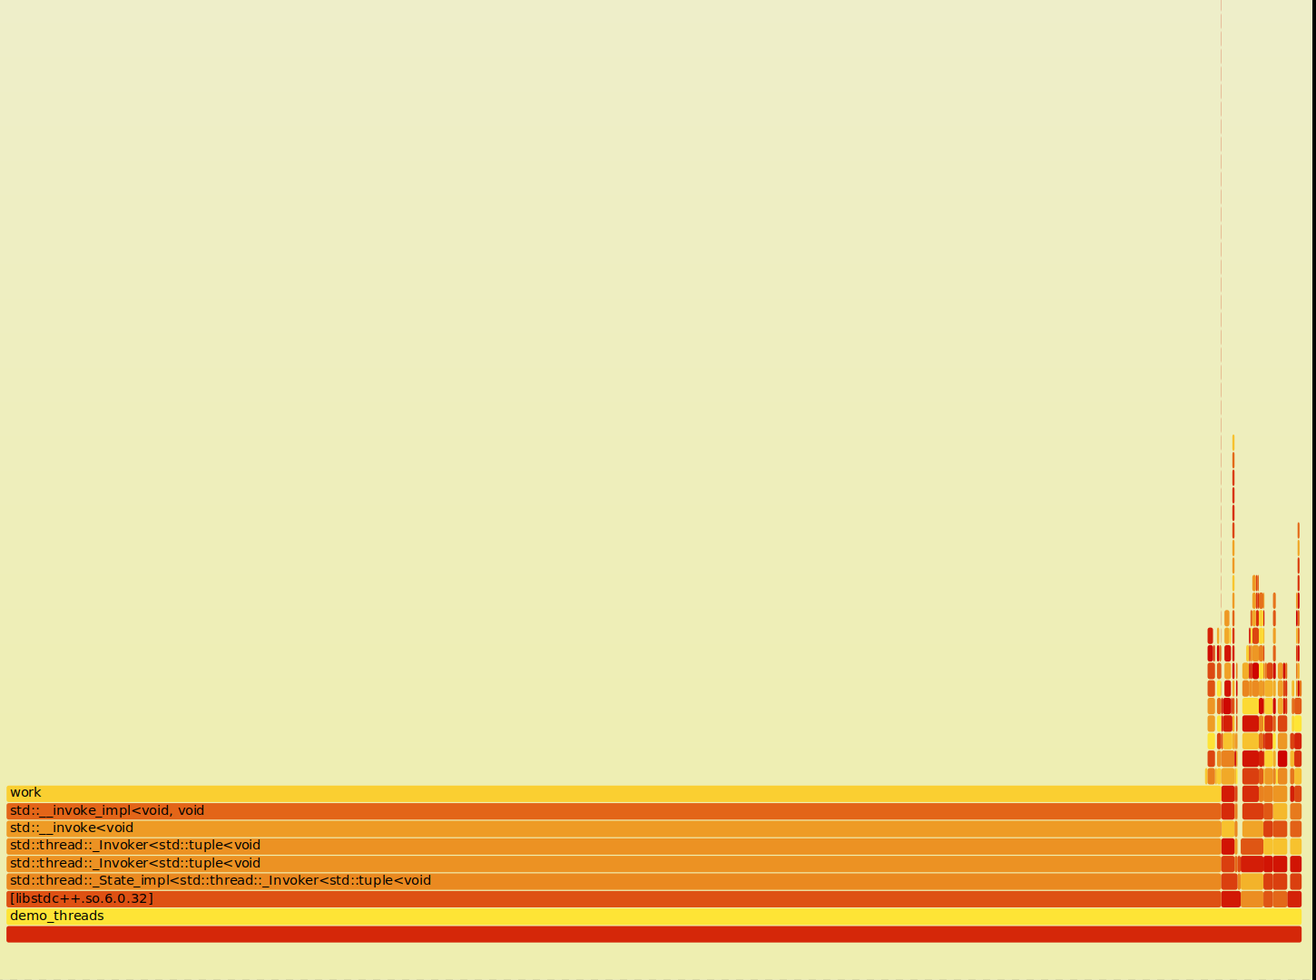
Not optimized

Slide 21
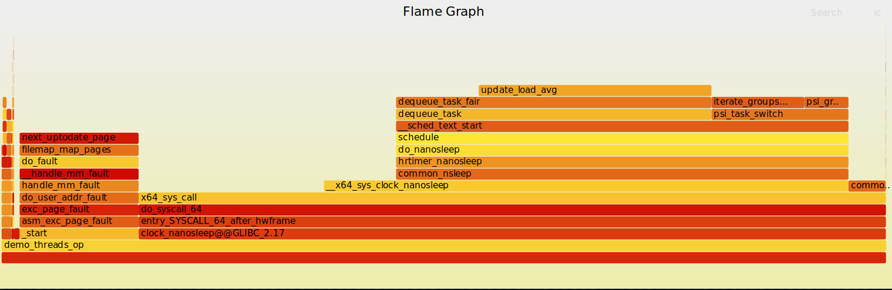
Optimized

